Slide 1

Targeting the toxic RNA of myotonic dystrophy
Andy Berglund
Biochemistry & Molecular Biology
Center for NeuroGenetics
College of Medicine
University of Florida

Slide 2
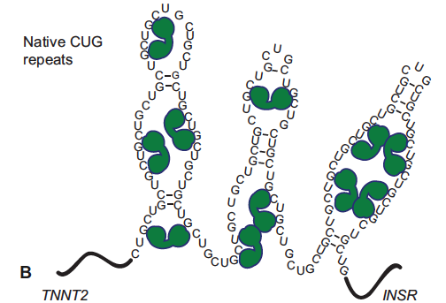
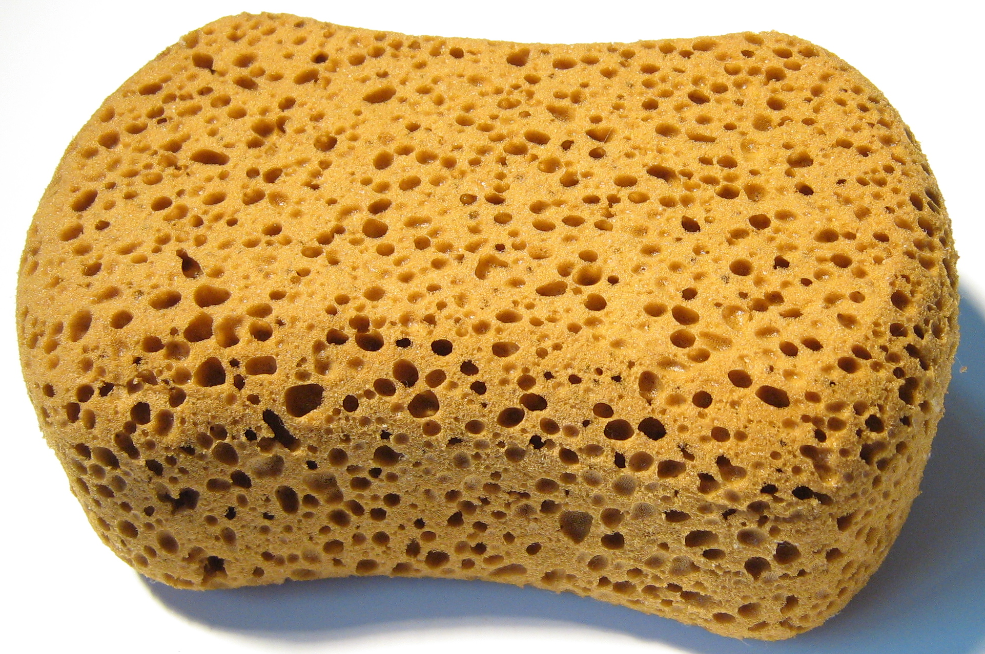
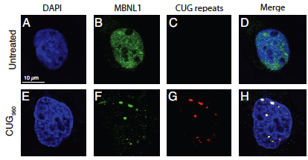
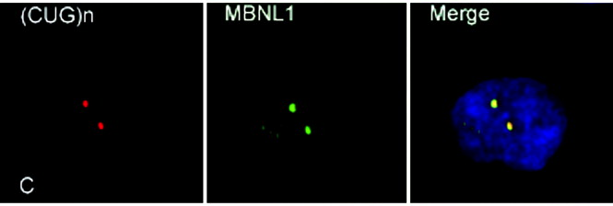
Muscleblind (MBNL) proteins are sequestered by the toxic RNA in myotonic dystrophy
MBNL
Toxic sponge
(~copy)
Wild type
CUG 960

Slide 3
Overview of DM disease mechanism
CTG/CCTG
CUG/CCUG
MBNL
Splicing
abnormalities
Clinical
Manifestations
DNA
RNA
(Antisense)
CAG/CAGG
CELF
RNA foci
?
RAN Translation
DNA RNA Proteins cellular function / body function (blueprints) (i.e. muscle contraction)

Slide 4
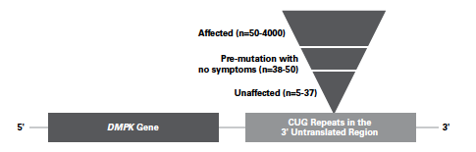
Widespread splicing dysregulation is observed in myotonic dystrophy type 1 (DM1) and type 2 (DM2)
Disease Symptoms | Mis-spliced transcript(s)
Myotonia | Chloride channel (CLCN1)
Insulin resistance | Insulin receptor (INSR)
Muscle weakness & wasting | ATP2A1, ATP2A2, RYR1, MTMR1
Cardiac abnormalities | Cardiac troponin T (TNNT2)
Cognitive Challenges | NMDAR1, APP, MAPT
Gastrointestinal motility issues
Many more… (100+)

Slide 5
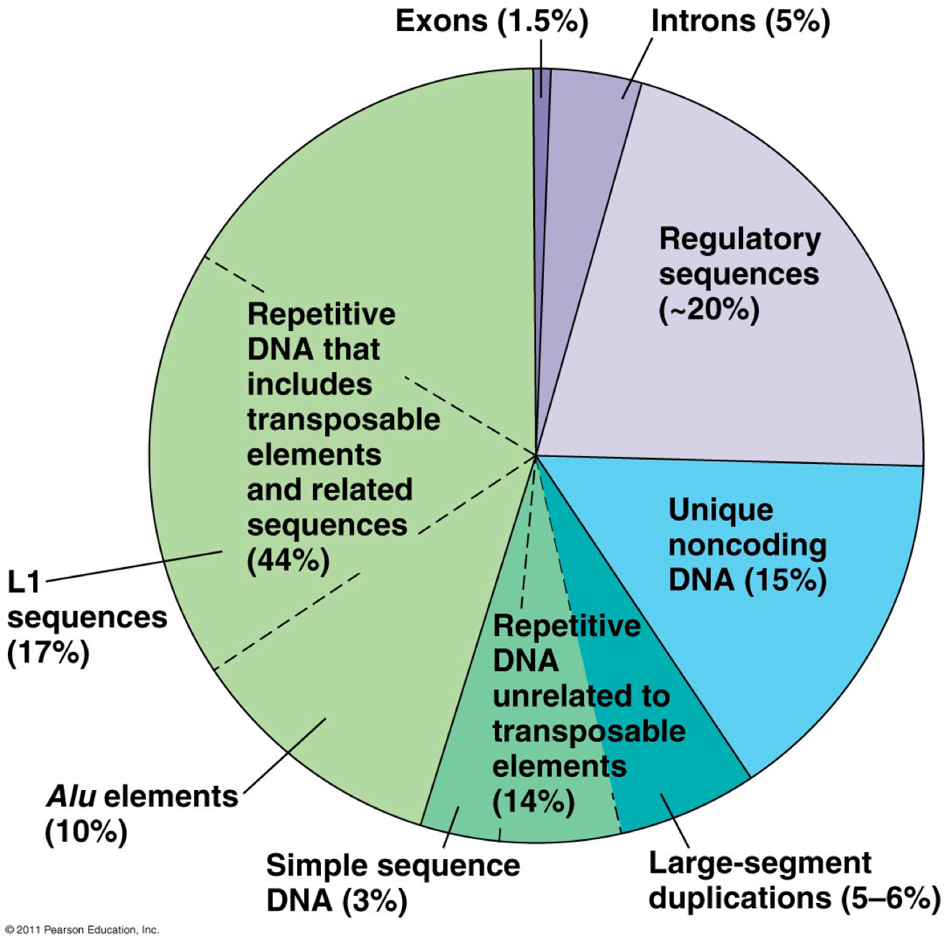
Make up of our genome

Slide 6
If all our cells have the same instructions (DNA) how do we get different types of cells?
By regulating the amount and type of message RNAs in the cell
Genes are complex and only a small part are ‘coding’
Exons are the coding component of genes
Introns
1
2
3
UTR
Promoter
Enhancers
Processing
1
2
3
Exons

Slide 7
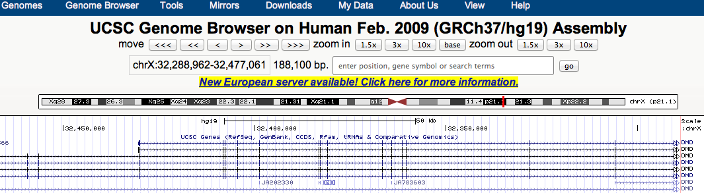
Browsing the genome
Where are the exons? – coding instructions
Where are the introns? – junk
Advantages to this organization?
Disadvantages?
http://genome.ucsc.edu/

Slide 8
Splicing out the introns (junk?) - extremely important
5’-ss
3’-ss
YAGGURAGU
CURAY
YYYYYYNYAGGU
Branchpoint
Py Tract
Exon A
GU
A
Py
YAG
Exon B
Exon A
Exon B

Slide 9
Alternative splicing allows different proteins to be made from the same genes
Exon skipping
Mutually exclusive exons
Alternate exon ending
Alternate exon beginning
Intron retention

Slide 10
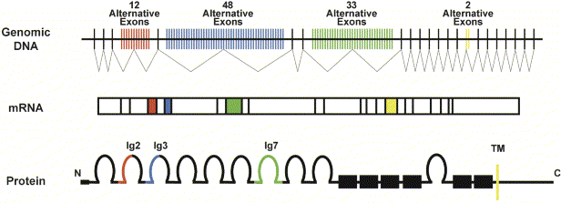
Advantage
Diversity of DSCAM gene in Drosophila
Wojtowicz WJ et al. (2004) Cell 118: 619
How many message RNAs can this one gene produce through splicing?
4 different message RNAs and 4 different proteins
40 different message RNAs and 40 different proteins
Nearly 40,000 different message RNAs and 40,000 different proteins

Slide 11
Advantage
Diversity of DSCAM gene in Drosophila
Wojtowicz WJ et al. (2004) Cell 118: 619
The Drosophila Dscam (Down syndrome cell adhesion molecule) gene has the potential to encode 38,000+ proteins. (Drosophila genome: ~13,000 genes)
(Human DSCAM only has a few splice isoforms)
Implicated in regulation of neuronal pathfinding

Slide 12
Overview of Therapeutic Design for DM
Small molecules
CRISPR
Viral delivery of MBNL1
CTG/CCTG
CUG/CCUG
MBNL
Splicing
abnormalities
Clinical
Manifestations
DNA
RNA
CELF
RNA foci
Antisense Oligos
Small molecules
Peptides
Ribozymes

Slide 13
Can we use small molecules or proteins/RNA to specifically inhibit the production of the toxic RNA of DM?
Small molecules that bind the long CTG/CCTG repeats and inhibit transcription?

Slide 14
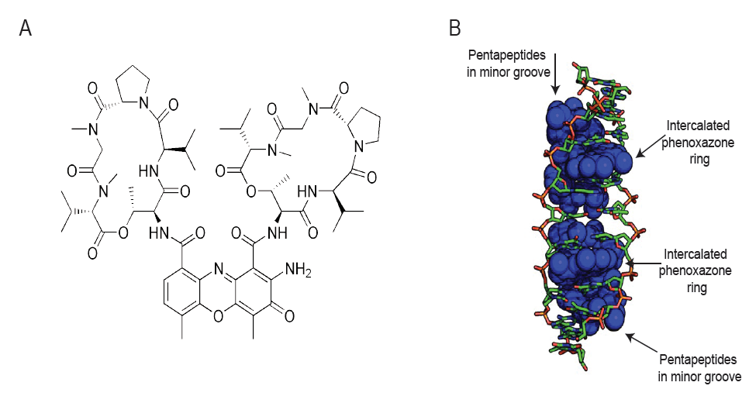
The transcription inhibitor Actinomycin D (ActD) binds GC repeats
Siboni et al. 2015 Cell Reports

Slide 15
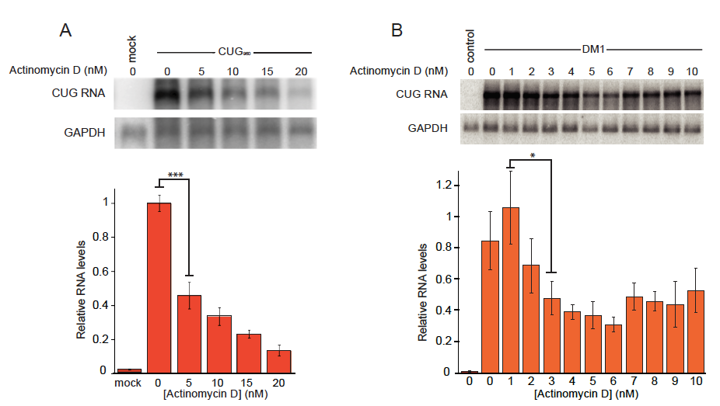
ActD reduces levels of CUG repeats
Siboni et al. 2015 Cell Reports

Slide 16
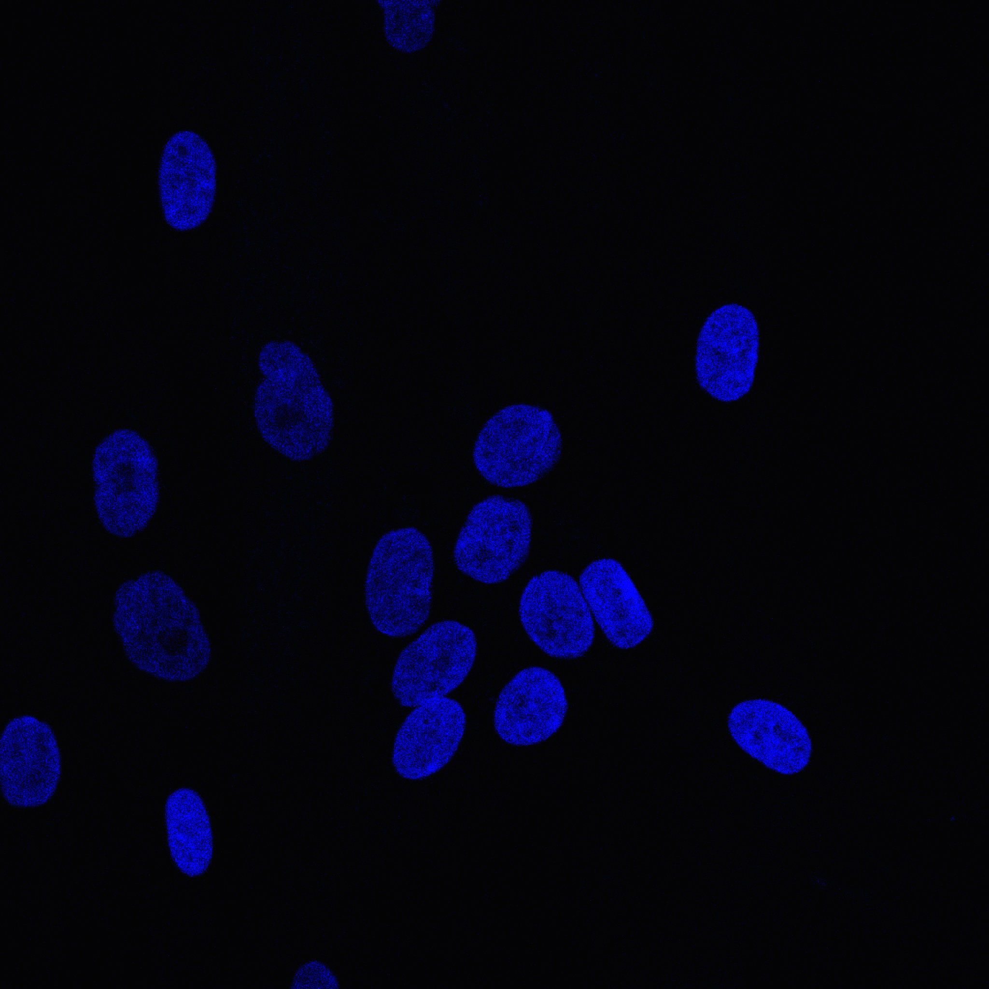
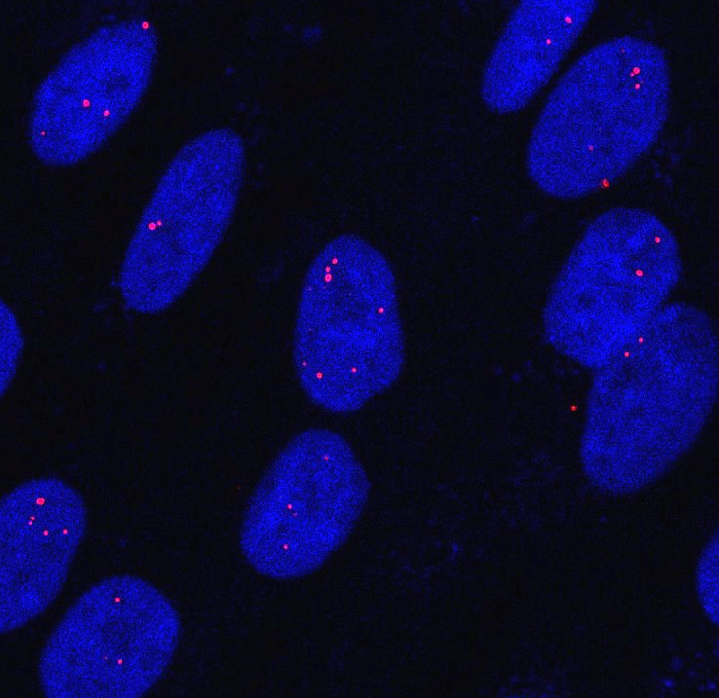
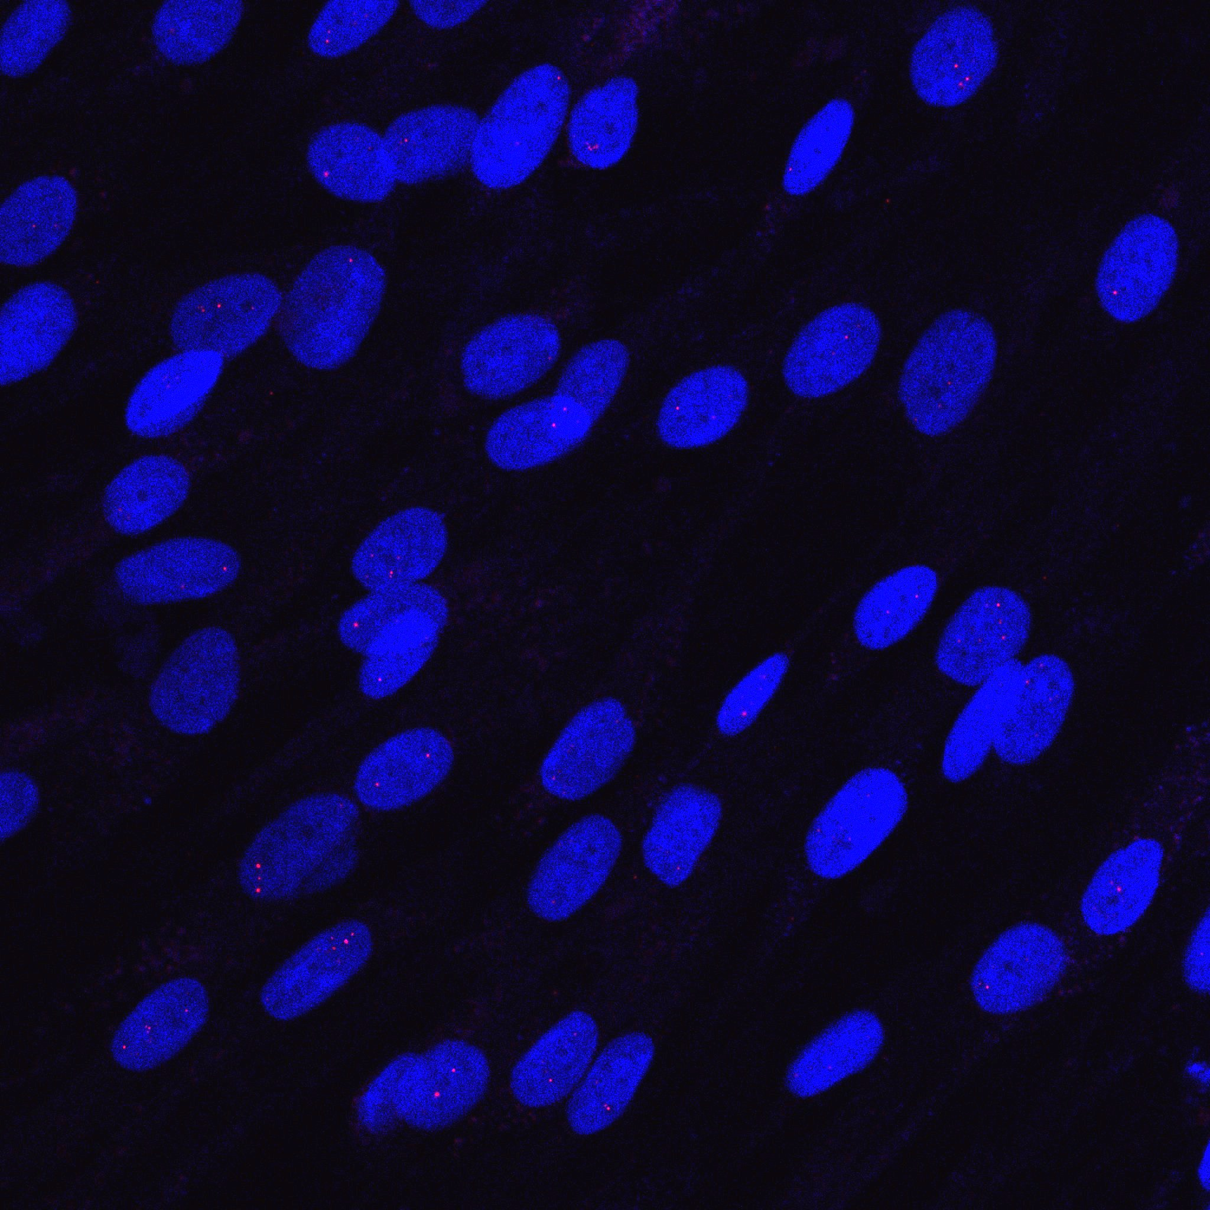
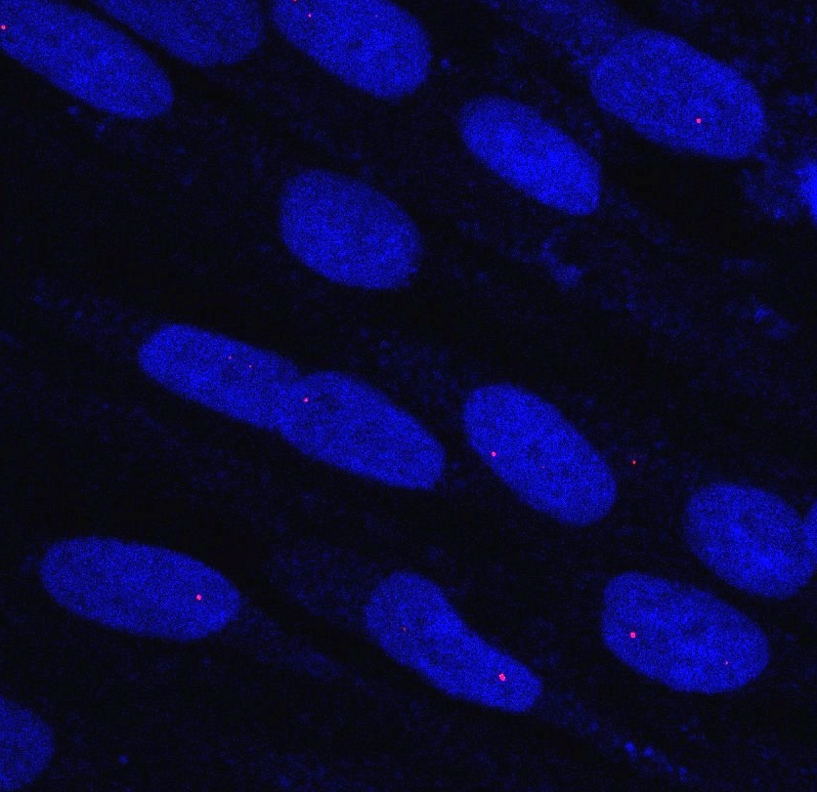
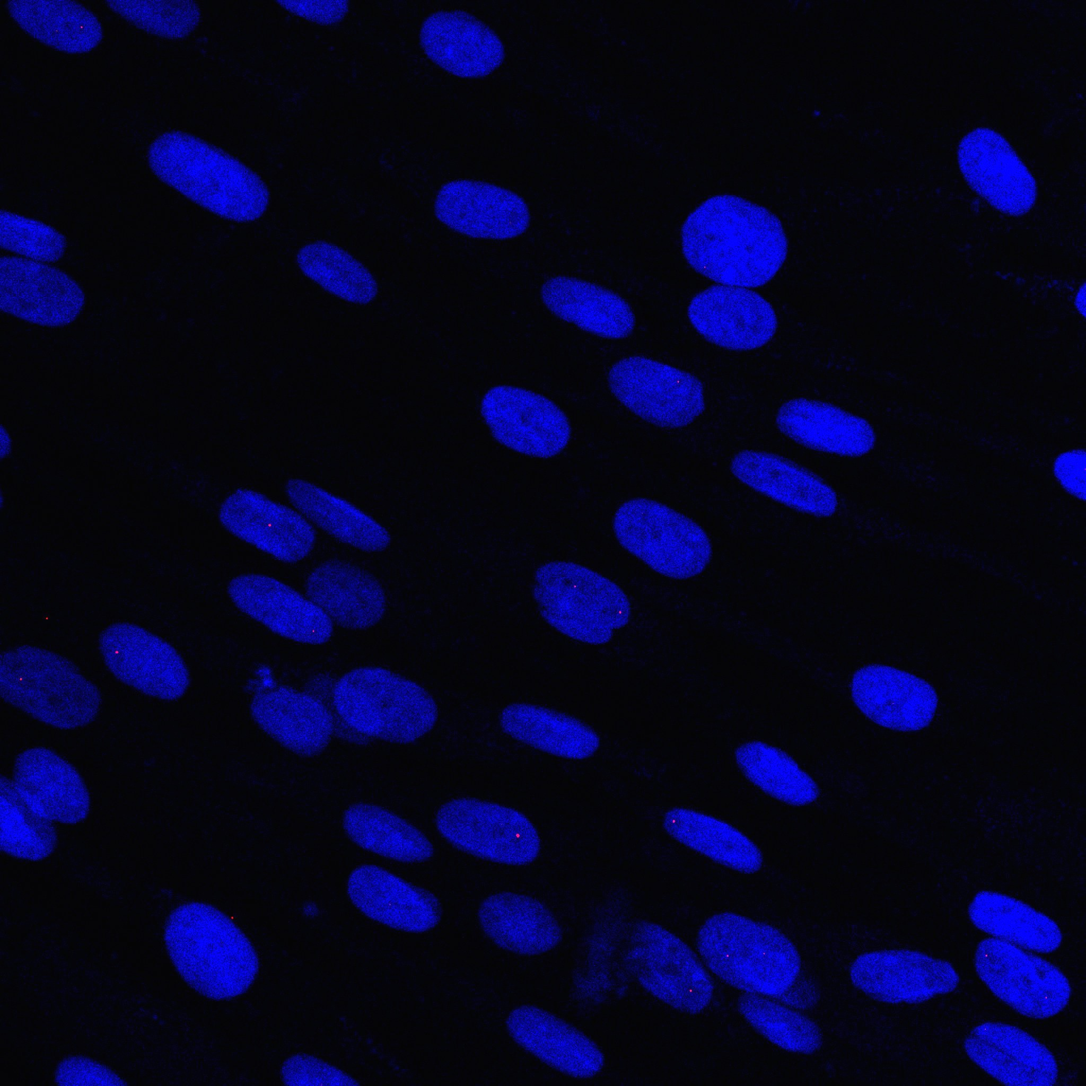
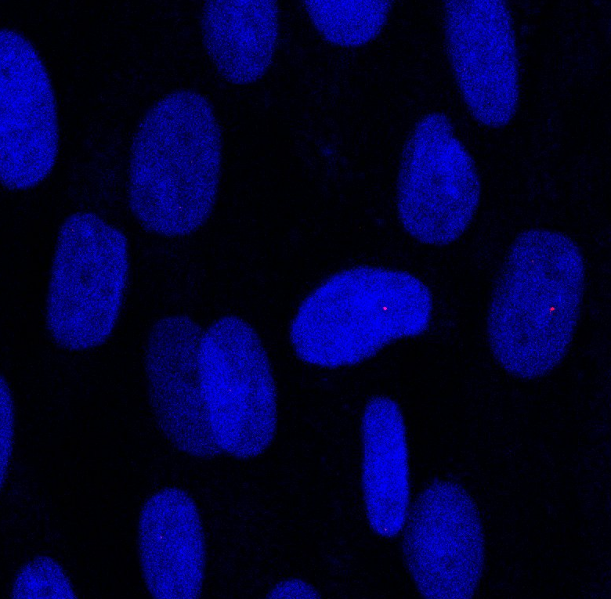
ActD reduces ribonuclear foci in patient-derived DM1 fibroblasts after 24 hrs of treatment
Control
Untreated
5nM
15nM
20nM
25nM
Jana Jenquin

Slide 17
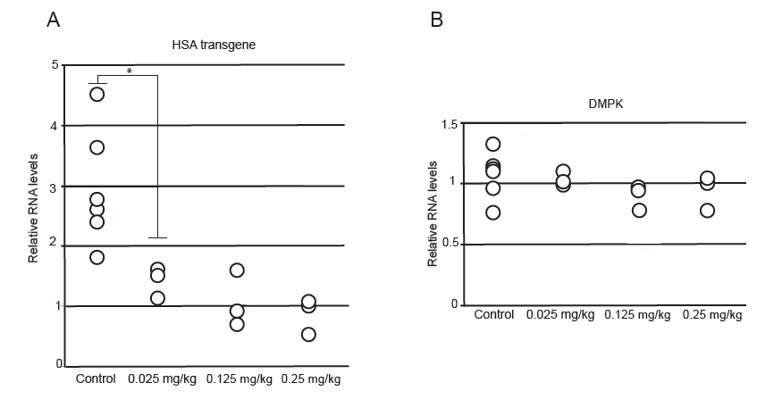
ActD reduces levels of CUG repeats in HSALR myotonic dystrophy type 1 mouse
Siboni et al. 2015 Cell Reports

Slide 18
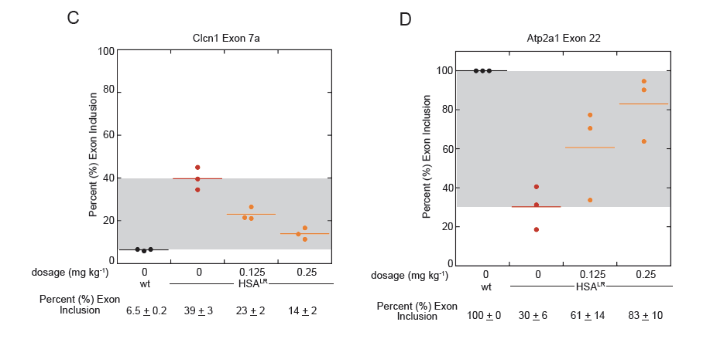
ActD rescues mis-splicing in DM1 mouse model
70 splicing events partially or fully rescued at 0.25 mg/kg ActD (RNAseq)
Siboni et al. 2015 Cell Reports

Slide 19
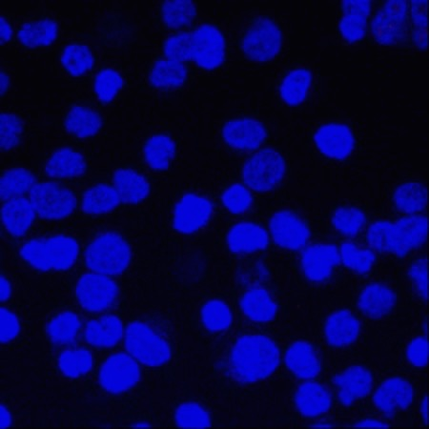
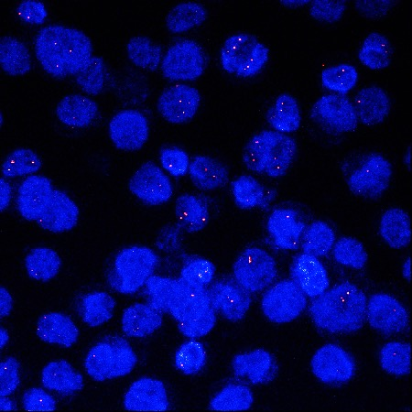
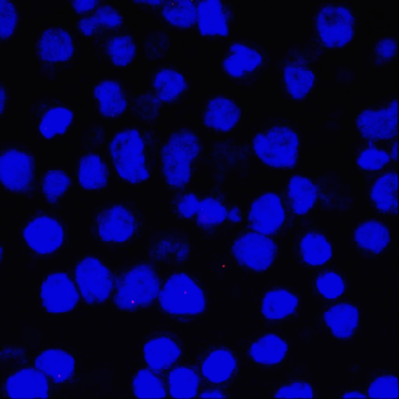
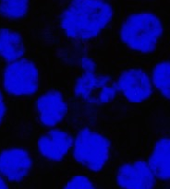
ActD eliminates ribonuclear foci in patient-derived DM2 LCLs after 48 hrs of treatment
Control
Untreated
10nM - 24 hrs
10nM - 48 hrs
Jana Jenquin

Slide 20
Screening for more small molecules that inhibit transcription of CUG/CCUG repeats
Three pronged approach
1
2
Mining the literature for molecules
Reduce CUG/CCUG RNA levels?
Foci reduction?
Specificity for expanded repeats?
High Throughput Assay to screen libraries
Identify an approach to measure CUG/ CCUG repeat RNA levels directly
In extracts and cells
Amenable to HTS
C #1
C #2
Multiplex qRT-PCR
Jana Jenquin
Kaalak Reddy

Slide 21
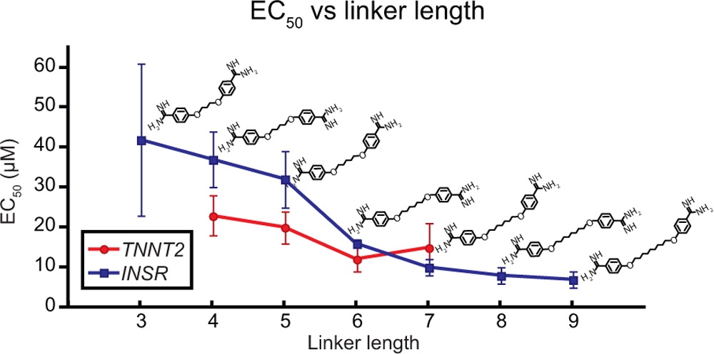
Third approach – continued development of diamidines
3
Splicing rescue increases with longer linker between amindine groups
Coonrod et al. ACS Chem Biol 2013

Slide 22
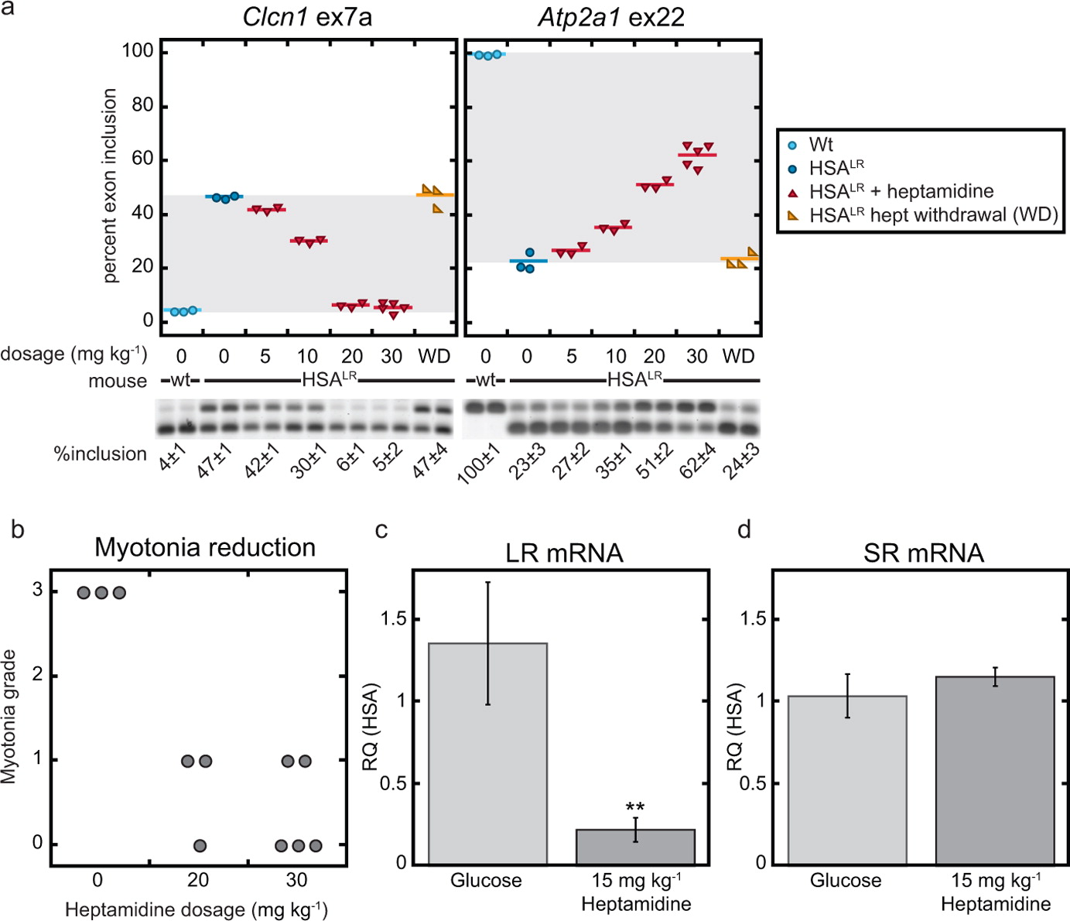
Splicing rescue in HSALR DM1 mouse model with heptamidine
Coonrod et al. ACS Chem Biol 2013

Slide 23
Rescue of myotonia in HSALR DM1 mouse model with heptamidine
Coonrod et al. ACS Chem Biol 2013

Slide 24
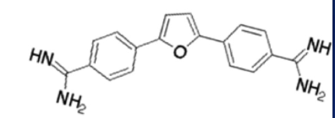
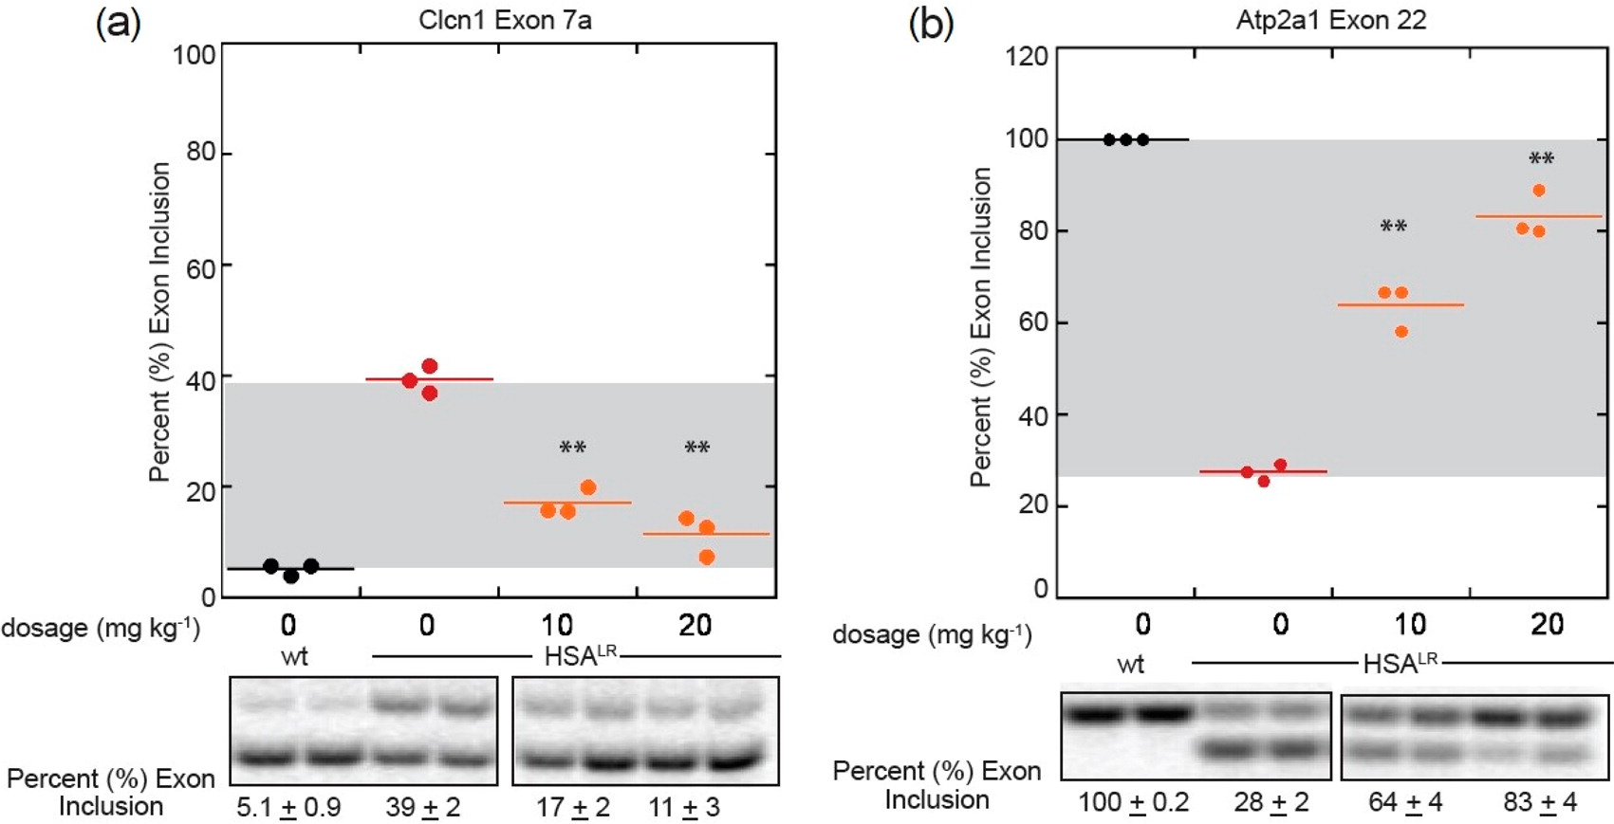
Splicing rescue with the low toxicity compound furamidine
Siboni et al. J Med Chem 2015

Slide 25
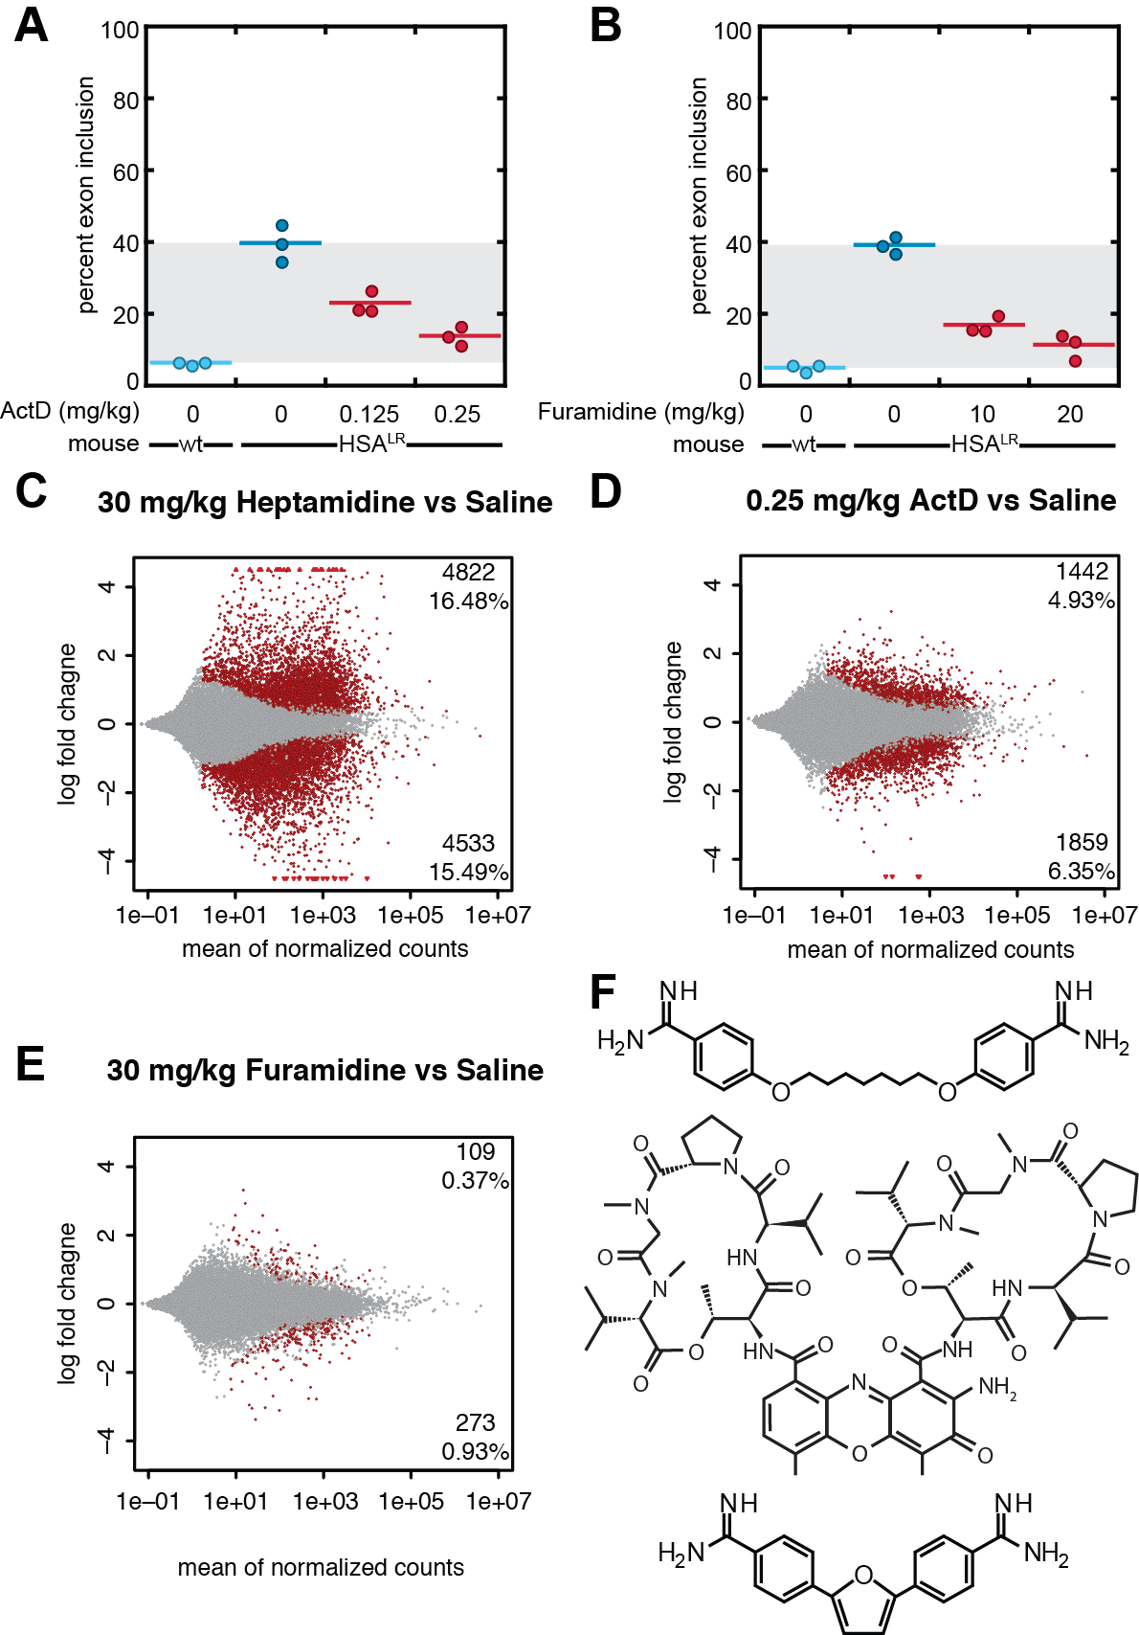
RNA-seq is consistent with toxicity studies
Leslie Coonrod

Slide 26
Summary and future work
Targeting transcription works
Affect on antisense transcription & RAN translation?
Can we increase specificity?
Crossing the blood brain barrier is important
Other microsatellite repeat diseases?
Spt4/5
Pol II
CTG/CCTG
100s to 1000s of repeats
Enhancer

Slide 27
Wang lab (inhibiting transcription with CRISPR)
Molecular Cell (Oct. 19th)

Slide 28


Acknowledgements
Stacey Wagner
Adam Struck (OHSU)
Amy Mahady
Ruth Siboni (NASA & Georgetown)
Sunny Ketchum (Grace Biolabs)
Matt Tanner (Rochester)
Melissa Hinman (UO - Karen Guillemin)
Elaine deLorimier
Leslie Coonrod
Mike Haley
  Micah Bodner
  Cameron Hilton
  Aaron Docter
  Muhammad Khalifa (Wisconsin)
Riti Gupta (Johns Hopkins)
Dylan Farnsworth (Doe lab – UO)
Julie Oddo (Bend Research)
Eric Wang and Chris Burge (MIT)
Charles Thornton (Rochester)
Masayuki Nakamori (Osaka)
Danielle Cass (Reed)
Melissa Hale
Jana Jenquin
Jared Richardson
Kaalak Reddy
Carl Shotwell
Jodi Bubenik (joint - Swanson)
Ranum lab
Swanson lab
Wang lab
Funding – NIH, MDA, MDF/Wyck, NSF and PTK

